Slide 1
Introduction to Data Science
John P Dickerson
Lecture #23 – 11/17/2020
Lecture #24 – 11/19/2020
CMSC320
Tuesdays & Thursdays
5:00pm – 6:15pm (… or anytime on the Internet)

Slide 2
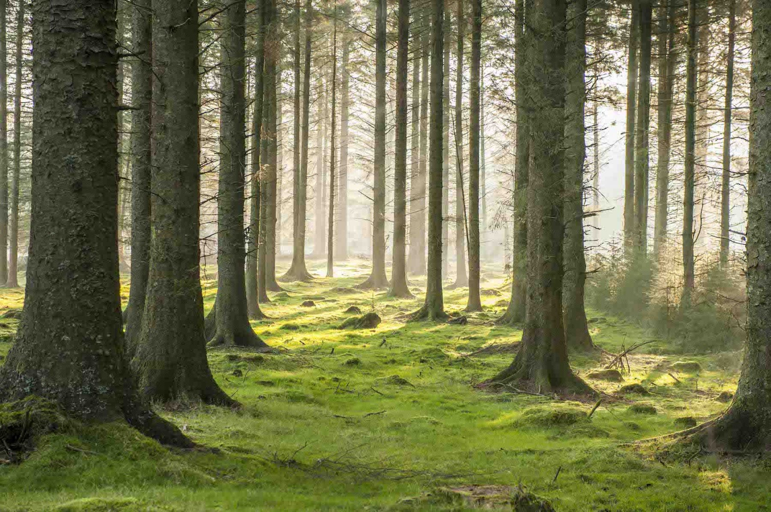
Quick Recap from last class …

Slide 3
Random Forests
Decision trees are very interpretable, but may be brittle to changes in the training data, as well as noise
Random forests are an ensemble method that:
Resamples the training data;
Builds many decision trees; and
Averages predictions of trees to classify.
This is done through bagging and random feature selection

Slide 4
Bagging
Bagging: Bootstrap aggregation
Resampling a training set of size n via the bootstrap:
Sample with replacement n elements
General scheme for random forests:
Create B bootstrap samples, {Z₁, Z₂, …, Z_{B}}
Build B decision trees, {T₁, T₂, …, T_{B}}, from {Z₁, Z₂, …, Z_{B}}
Classification/Regression:
Each tree T_{j} predicts class/value y_{j}
Return average 1/B Σ_{j={1,...,B}} y_{j} for regression, or majority vote for classification

Slide 5
obs_id | ft_1 | ft_2
1 | 12.2 | puppy
2 | 34.5 | dog
3 | 8.1 | cat
Original training dataset (Z):
B Bootstrap samples Z_{j}
Z₁
Z₂
Z_{B}
obs_id | ft_1 | ft_2
3 | 8.1 | cat
2 | 34.5 | dog
3 | 8.1 | cat
obs_id | ft_1 | ft_2
1 | 12.2 | puppy
2 | 34.5 | dog
1 | 12.2 | puppy
obs_id | ft_1 | ft_2
1 | 12.2 | puppy
1 | 12.2 | puppy
3 | 8.1 | cat
T₁
T₂
T_{j}
T_{B}
Aggregate/Vote
Class estimate or predicted value

Slide 6
Random Attribute selection
We get some randomness via bootstrapping
We like this! Randomness increases the bias of the forest slightly at a huge decrease in variance (due to averaging)
We can further reduce correlation between trees by:
For each tree, at every split point …
… choose a random subset of attributes …
… then split on the “best” (entropy, Gini) within only that subset

Slide 7
Random forests in scikit-learn
from sklearn.ensemble import RandomForestClassifier
# Train a random forest of 10 default decision trees
X = [[0, 0], [1, 1]]
Y = [0, 1]
clf = RandomForestClassifier(n_estimators=10)
clf = clf.fit(X, Y)
Can we get even more random?!
Extremely randomized trees (ExtraTreesClassifier) do bagging, random attribute selection, but also:
At each split point, choose random splits
Pick the best of those random splits
Similar bias/variance performance to RFs, but can be faster computationally

Slide 8
Announcements
Project #3 is extended to Thursday, December 3rd.
Project #4 should be out by then, too!
This is the shortest project (by far)
It’s also fun! You should do it fast and early ☺.
Project #4 will likely be due on December 10th.
Questions about the final tutorial ?????????

Slide 9
Quick Aside for Project #3
Precision P: #correct positive results / #positive results returned
Recall R: #correct positive results / #all possible positive results

Slide 10
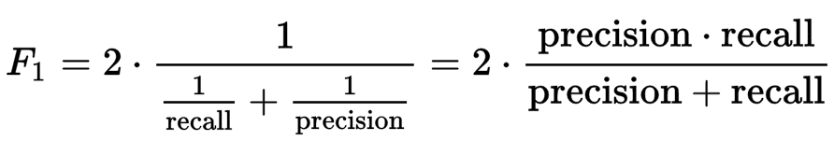
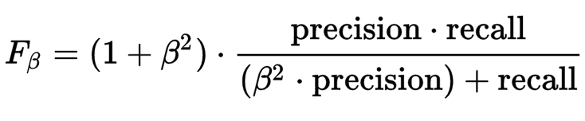
Quick Aside for Project #3
F-Score F: weighted average of the precision and recall of a test
F₁: (harmonic) mean of precision and recall:
Can be parameterized to attach higher importance to recall:
Notes:
Harmonic mean = good for rates vs absolute numbers

Slide 11
Today’s Lecture
Data collection
Data processing
Exploratory analysis
&
Data viz
Analysis, hypothesis testing, & ML
Insight & Policy Decision

Slide 12
Filling in the gaps: Nonlinear regression & Regularization
Thanks: Zico Kolter

Slide 36
combinations_with_replacement(p,r):
r-length tuples, in sorted order, with replacement

Slide 49
LEARNING

Slide 53
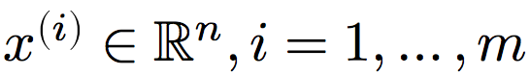
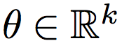
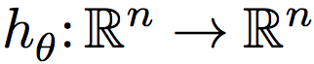
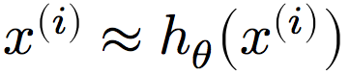
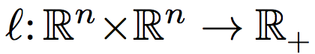
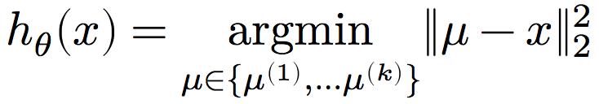
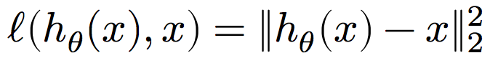
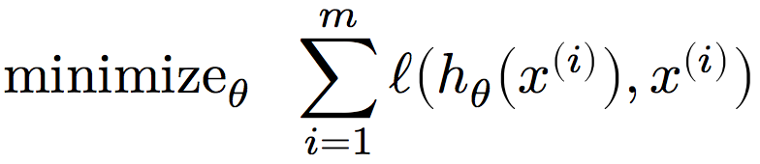
Unsupervised Learning
Input features:
Model parameters:
Hypothesis function: ??????????????
Want: approximate input given input, or
Loss function:

Slide 57
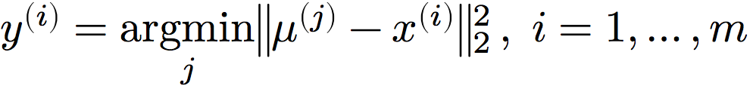
K-Means
Non-convex optimization problem → locally good solutions
Given: dataset x^{(i)}, number of clusters k
Initialize k cluster centers:
Repeat until convergence or bored:
Compute cluster assignments:
Re-compute the new cluster means:

Slide 59
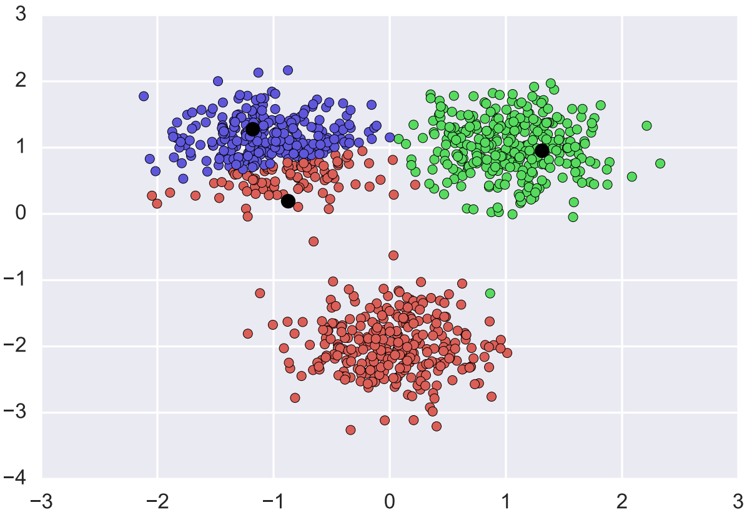
A (Lucky) example

Slide 60
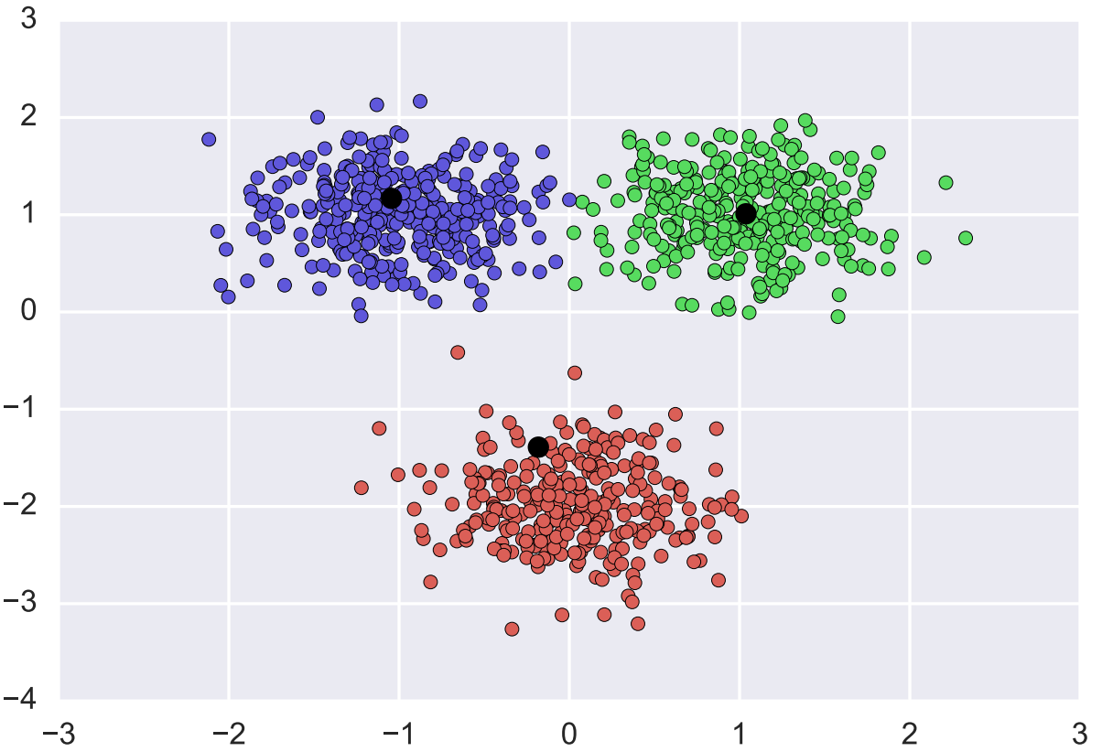
A (Lucky) example

Slide 61
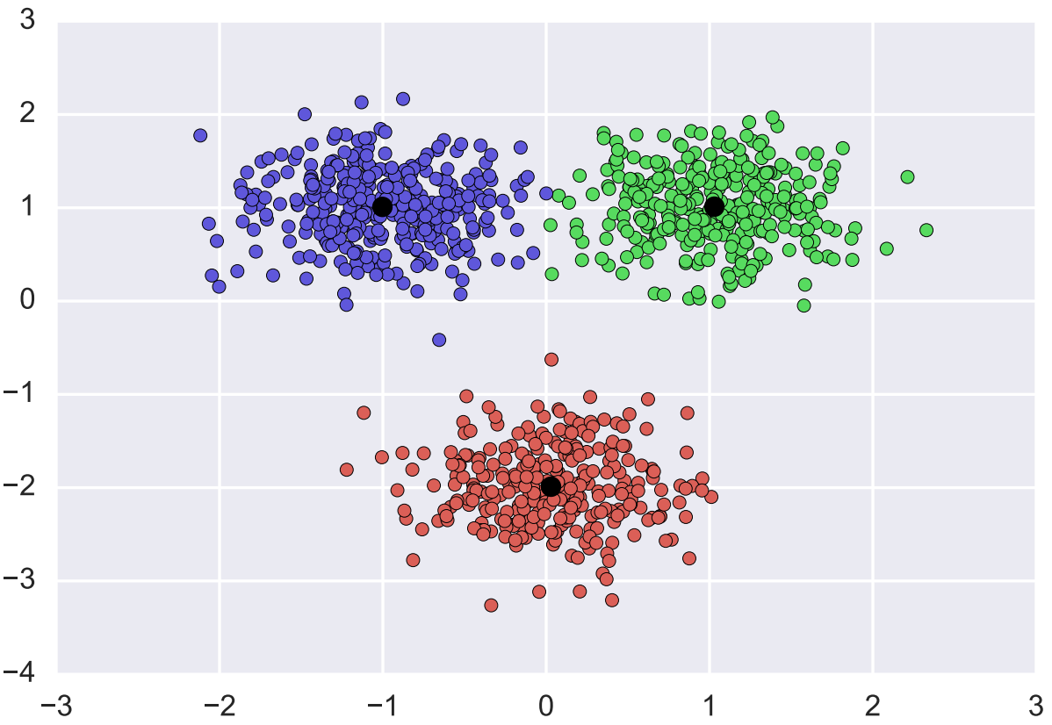
A (Lucky) Example

Slide 71
Dimensionality reduction
Thanks to: Zico Kolter

Slide 72
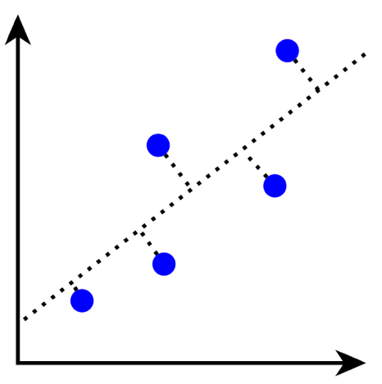
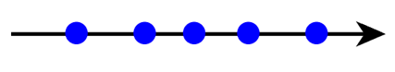
Principal Component Analysis (PCA)
So you’ve measured lots of features …
Overfitting, interpretability issues, visualization, computation
Principal component analysis (PCA) does this by preserving the axis of major variation in the data:
Can we combine raw features into new features that yield a simpler description of the same system?
Images: Zico Kolter

Slide 73
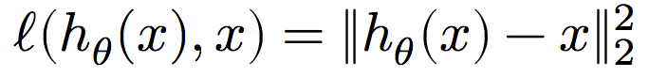
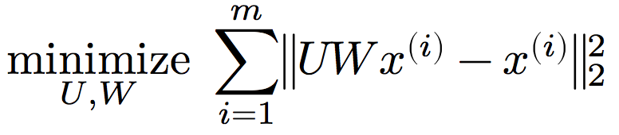
Principal Component Analysis (PCA)
Assume: data is normalized ??????????
Zero mean, unit (= 1) variance
Hypothesis function:
First multiply input by low rank matrix W (“compress” it), then map back into the initial space using U
Loss function: squared distance (like k-means)
Optimization problem:

Slide 74
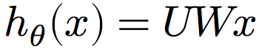
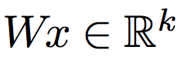
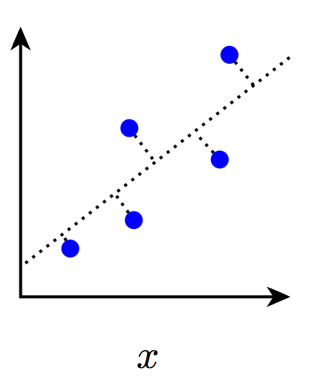
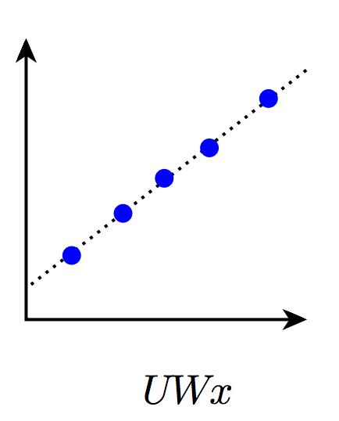
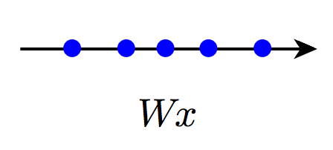
Principal Component Analysis (PCA)
Dimensionality reduction: main use of PCA for data science applications
If , then is a reduced (probably with some loss) representation of input features x

Slide 75
Principal Component Analysis (PCA)
CMSC422
MATH240
PCA optimization problem is non-convex ???????????
We can solve the problem exactly using the singular value decomposition (SVD):
Factorize matrix M = U Σ V^{T} (also used to approximate)
r x n
m x n
m x r
r x r
≈
M
U
Σ
V^{T}

Slide 76
Principal Component Analysis (PCA)
Solving PCA exactly using the SVD:
Normalize input data, pick #components k
Compute (exact) SVD of X = U Σ V^{T}
Return:
U = V_{:,1:k} Σ⁻¹_{1:k,1:k}
W = V^{T}_{:,1:k}
Loss is
CMSC422
MATH240

Slide 77
PCA in Python
Can roll your own PCA easily (assuming a call to SVD via SciPy or similar) …
… or just use Scikit-Learn:
from sklearn.decomposition import PCA
X=np.array([[-1,-1],[-2,-1],[-3,-2],[1,1],[2,1],[3,2]])
# Fit PCA with 2 components (i.e., two final features)
pca = PCA(n_components=2)
pca.fit(X)
print(pca.explained_variance_ratio_)
[ 0.99244... 0.00755...]
Looks like our data basically sit on a line

Slide 78
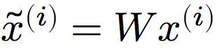
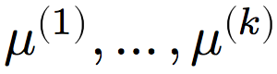
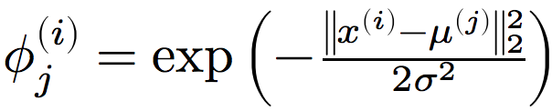
How to use PCA & Friends in practice
Unsupervised learning methods are useful for EDA
Cluster or reduce to a few dimensions and visualize!
Also useful as data prep before supervised learning!
Run PCA, get W matrix
Transform – (reduce colinearity, dimension)
Train and test your favorite supervised classifier
Or use k-means to set up radial basis functions (RBFs):
Get k centers
Create RBF features

Slide 79
Recommender Systems & Collaborative filtering

Slide 80
Netflix Prize
Recommender systems: predict a user’s rating of an item
Netflix Prize: $1MM to the first team that beats our in-house engine by 10%
Happened after about three years
Model was never used by Netflix for a variety of reasons
Out of date (DVDs vs streaming)
Too complicated / not interpretable
 | Twilight | Wall-E | Twilight II | TFotF
User 1 | +1 | -1 | +1 | ?
User 2 | +1 | -1 | ? | ?
User 3 | -1 | +1 | -1 | +1

Slide 81
Recommender Systems
Recommender systems feel like:
Supervised learning (we know the user watched some movies, so these are like labels)
Unsupervised learning (we want to find latent structure, e.g., genres of movies)
They fall somewhere in between, in “Information Filtering” or Information Retrieval” …
… but we can still just phrase the problem in terms of hypothesis classes, loss functions, and optimization problems

Slide 82
Prediction
Pure user information:
Age
Location
Profession/Salary
Pure item information:
Movie budget
Main actors
Is it a Netflix release?
User-item information:
Which items are most similar to those I’ve watched before?
Which users are most similar to me, and what did they watch?

Slide 83
Collaborative filtering
Collaborative filtering (CF): recommender systems that predict based only on the expressed preferences of other users for an item
 | i₁ | i₂ | i₃ | i₄
u₁ | 1 |  |  | 3
u₂ |  | 2 | 5
u₃ |  | 3 |  | 5
u₄ | 4 |  | 4
X =
Rows are users
Cols are items

Slide 84
Matrix view
Goal: “fill in” the matrix
The matrix is sparse, but the empty cells are not (necessarily) zero!
 | i₁ | i₂ | i₃ | i₄
u₁ | 1 | ? | ? | 3
u₂ | ? | 2 | 5 | ?
u₃ | ? | 3 | ? | 5
u₄ | 4 | ? | 4 | ?

Slide 85
Approaches to CF
User-user:
Find users who look like me – based on items that we’ve both rated
Predict scores for my unrated items as average of those users
Item-item:
Find similar items (based on scores from all users who have rated), predict scores for other users based off this
Matrix factorization:
Find a low-rank decomposition of X that agrees (exactly, approximately) at the observed values

Slide 86
Approach #1: Item-based CF Ex: infer (user 1, item 3)
 | Item 1 | Item 2 | Item 3 | Item 4 | Item 5
User 1 | 8 | 1 | ? | 2 | 7
User 2 | 2 | ? | 5 | 7 | 5
User 3 | 5 | 4 | 7 | 4 | 7
User 4 | 7 | 1 | 7 | 3 | 8
User 5 | 1 | 7 | 4 | 6 | ?
User 6 | 8 | 3 | 8 | 3 | 7
Example due to Qiang Yang [HKUST]

Slide 87
How to Calculate Similarity (ItemS 3 and 5)?
 | Item 1 | Item 2 | Item 3 | Item 4 | Item 5
User 1 | 8 | 1 | ? | 2 | 7
User 2 | 2 | ? | 5 | 7 | 5
User 3 | 5 | 4 | 7 | 4 | 7
User 4 | 7 | 1 | 7 | 3 | 8
User 5 | 1 | 7 | 4 | 6 | ?
User 6 | 8 | 3 | 8 | 3 | 7
Example due to Qiang Yang [HKUST]

Slide 88
Similarity between Items
Item 3 | Item 4 | Item 5
? | 2 | 7
5 | 7 | 5
7 | 4 | 7
7 | 3 | 8
4 | 6 | ?
8 | 3 | 7
How should we calculate the similarity between two items (e.g., items 3 and 5)?
We’ve done this before in a different context!
Notes:
Each row in the table are the ratings one user on the items
88

Slide 89
Similarity between items
Item 3 | Item 5
? | 7
5 | 5
7 | 7
7 | 8
4 | ?
8 | 7
Only consider users (i.e., rows) who have rated both items (i.e., non-empty)
One approach: For each user: Calculate difference in ratings for the two items
Take the average of this difference over the users
Another approach: cosine similarity!
Can also use Pearson Correlation Coefficients (also in user-user approach)
sim(item 3, item 5) = cosine( (5, 7, 7, 8), (5, 7, 8, 7) )
= (5*5 + 7*7 + 7*8 + 8*7)/(sqrt(5²+7²+7²+8²)* sqrt(5²+7²+8²+7²))
Notes:
Each row in the table are the ratings one user on the items
89

Slide 90
Prediction: Calculating ranking r(user1,item3)
Item 2
8
1
Item 1
Item 3
Item 5
7
Where α is a normalization factor, which is
1/[the sum of all sim(item_{i},item₃)].
Item 4
2
Notes:
Showing five items, Item 3 is the one we need to know for User 1. Distances to Item 3 indicate similarity. Numbers in yellow boxes give ratings for User 1 for other items.
Blue area shows nearest neighbours, items that are most similar to Item 3 based on past ratings by other users.
90

Slide 91
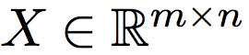
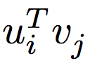
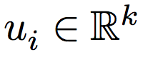
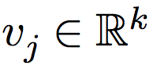
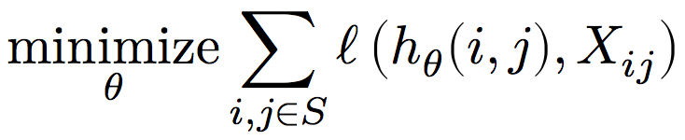
Approach #2: CF via Matrix factorization
Want: all entries i, j of ratings matrix
Idea: approximate as
User-specific weights
Item-specific weights
Hypothesis function: ???????????
Loss function: least squares on observed entries
Optimization problem: (S is observed entries)

Slide 92
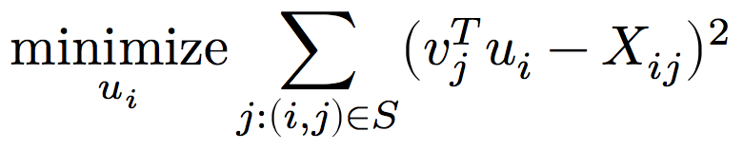
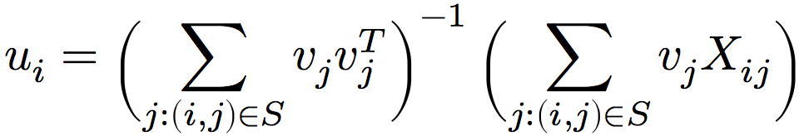
Optimization for CF
Matrix factorization is non-convex; we won’t go for perfect
Consider the objective w.r.t. a single term u_{i}:
Just a least squares problem! Analytic solution (from earlier):
Idea (not optimal): repeatedly solve for all u_{i}, v_{j} until converged or bored

Slide 93
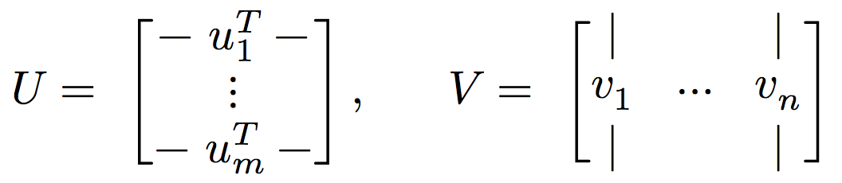
What are we doing?
Factorizing the ratings matrix X as
with
But we are only penalizing mismatches between UV and X at the observed entries in X

Slide 94
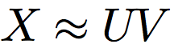
Isn’t this just PCA?
PCA also performs a factorization
Or more precisely
In PCA, all entries are observed (or imputed beforehand)
Simplifies the solution to PCA (which we can solve exactly via the SVD) versus CF via matrix factorization (which we cannot)

Slide 95
(Some more) Recommender Systems (ISH)

Slide 96
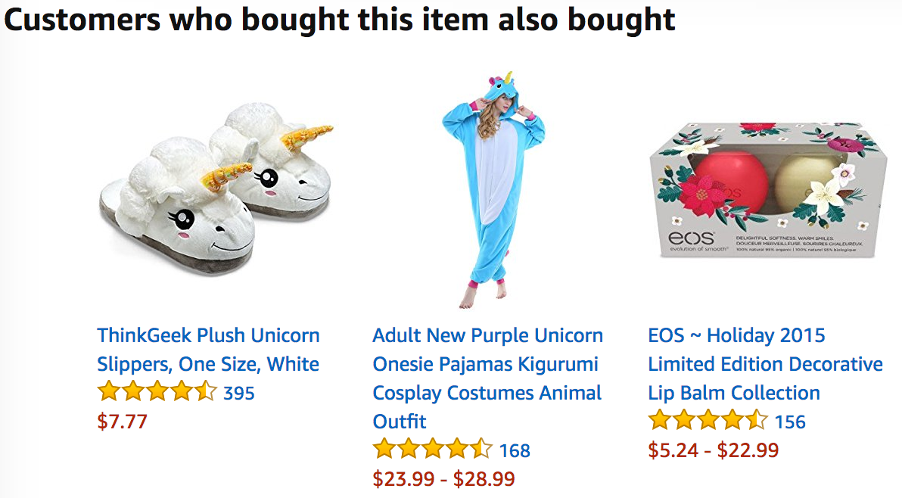
Association rules
Last time: CF systems give predictions based on other users’ scores of the same item
Complementary idea: Find rules that associate the presence of one set of items with that of another set of items

Slide 97
Format of Association Rules
Typical Rule form:
Body → Head
Body and Head can be represented as sets of items (in transaction data) or as conjunction of predicates (in relational data)
Support and Confidence
Usually reported along with the rules
Metrics that indicate the strength of the item associations
Examples:
{diaper, milk} → {beer} [support: 0.5%, confidence: 78%]
buys(x, "bread") /\ buys(x, “eggs") → buys(x, "milk") [sup: 0.6%, conf: 65%]
major(x, "CS") /\ takes(x, "DB") → grade(x, "A") [1%, 75%]
age(x,30-45) /\ income(x, 50K-75K) → owns(x, SUV)
age=“30-45”, income=“50K-75K” → car=“SUV”
Thanks to: Bamshad Mobasher

Slide 98
Association Rules: Basic Concepts
Let D be database of transactions
Let I be the set of items that appear in the database:
e.g., I = {A, B, C, D, E, F}
Each transaction t is a subset of I
A rule is an implication among itemsets X and Y, of the form by X → Y, where X ⊂ I, Y ⊂ I, and X ∩ Y= ∅
e.g.: {B,C} → {A}
Transaction ID | Items
1000 | A, B, C
2000 | A, B
3000 | A, D
4000 | B, E, F
Thanks to: Bamshad Mobasher
Notes:
98

Slide 99
Association Rules: Basic Concepts
Itemset
A set of one or more items
E.g.: {Milk, Bread, Diaper}
k-itemset
An itemset that contains k items
Support count (σ)‏
Frequency of occurrence of an itemset (number of transactions in which it appears)
E.g. σ({Milk, Bread,Diaper}) = 2
Support
Fraction of the transactions in which an itemset appears
E.g. s({Milk, Bread, Diaper}) = 2/5
Frequent Itemset
An itemset whose support is greater than or equal to a minsup threshold
Customer
buys both
Customer
buys diaper
Customer
buys beer
Notes:
99

Slide 100
Association Rules: Basic Concepts
Association Rule
X → Y, where X and Y are non-overlapping itemsets
{Milk, Diaper} → {Beer}
Rule Evaluation Metrics
Support (s)‏
Fraction of transactions that contain both X and Y
i.e., support of the itemset X ∪ Y
Confidence (c)‏
Measures how often items in Y appear in transactions that contain X
Example:
Notes:
100

Slide 101
Association Rules: Interestingness
Another interpretation of support and confidence for X → Y
Support is the probability that a transaction contains {X ∪ Y} or Pr(X /\ Y)
Confidence is the conditional probability that a transaction will contains Y given that it contains X or Pr(Y | X)
support(X → Y) = support(X ∪ Y) = σ(X ∪ Y) / |D|
confidence(X → Y) = σ(X ∪ Y) / σ(X)
= support(X ∪ Y) / support(X)
Notes:
101

Slide 102
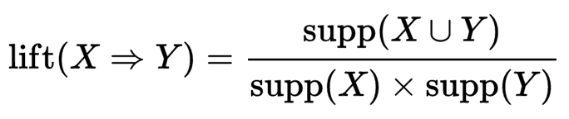
Association Rules: Interestingness
Other considerations of how interesting a rule is:
If lift is equal to 1 ??????????
Body X and Head Y are independent
If lift is greater than 1 ?????????
Body X and Head Y are in some sense dependent
Conviction measures frequency of X and Y occurring together, vs. how frequently X occurs but not Y
Many others …

Slide 103
Association Rules in Practice
Orange3 is a {GUI, Python API, …} that:
Enumerates frequent itemsets
Performs association rule mining
(Wrapper calls to, shared functionality with, Scikit-Learn)
conda install –c ales-erjavec orange3
More information: https://blog.biolab.si/2016/04/25/association-rules-in-orange/
In general:
Can be useful for interpretable, fast data mining
Typically doesn’t consider order, scalability issues …

